Slide 1
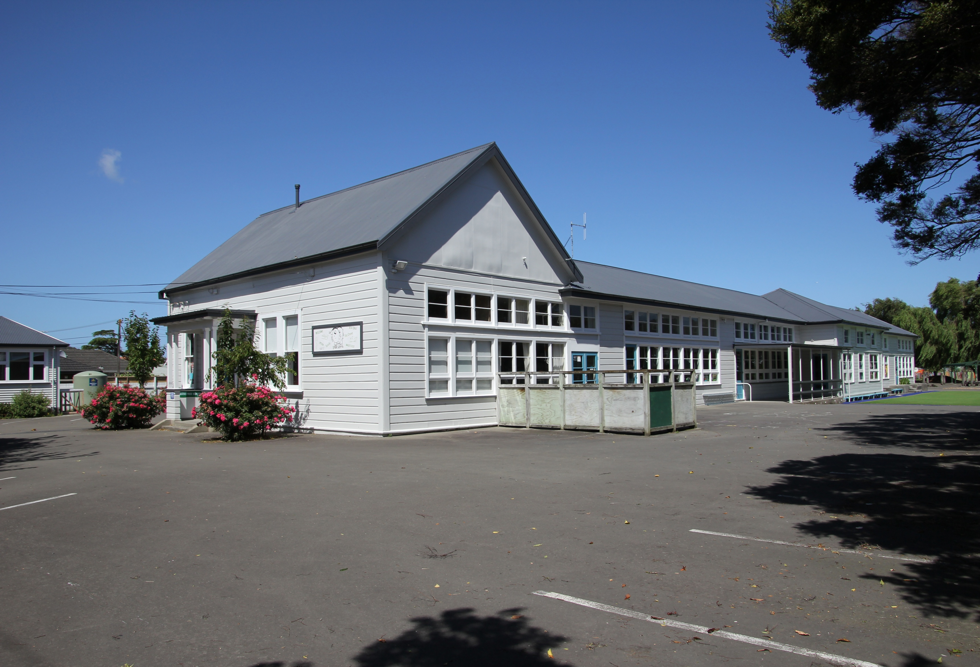
Epuni Primary School LED Lighting Trial 2016 Final Report

Slide 2
In late 2015, the Dynamis Project, assisted by the Ministry of Education, converted Epuni Primary School, in Lower Hutt, to LED lighting.
Astara Technologies installed data loggers into the school’s main and sub power distribution boards to measure the power usage of the power and lighting circuits to compare the before and after effect of the LED lighting upgrade.
Tristram Jay Electrical changed all the lamps and tubes in the school over to LED on these dates:
14th November exterior floodlights
15th November School Hall
21st November Main School block
The lighting and power use was measured for one month before the changeover and the sub circuit loggers were removed 23rd December 2015
The lighting draw showed an average reduction of 81%
The main building logger remained and power use for this building was logged for a full year. This logger was removed on 10th October 2016

Slide 3
Power Profile Loggers
Fitted to the main distribution board supply inputs (3 phase into the main school and 2 phase into the hall).
Fitted to the lighting circuits identified by the electrician.
Logs at 10 second intervals to storage.
Data is collected from the main supply phases and the lighting circuits.
5 loggers fitted, three of which are multi channel (6, 5 and 3 channels), and two single channel.

Slide 4
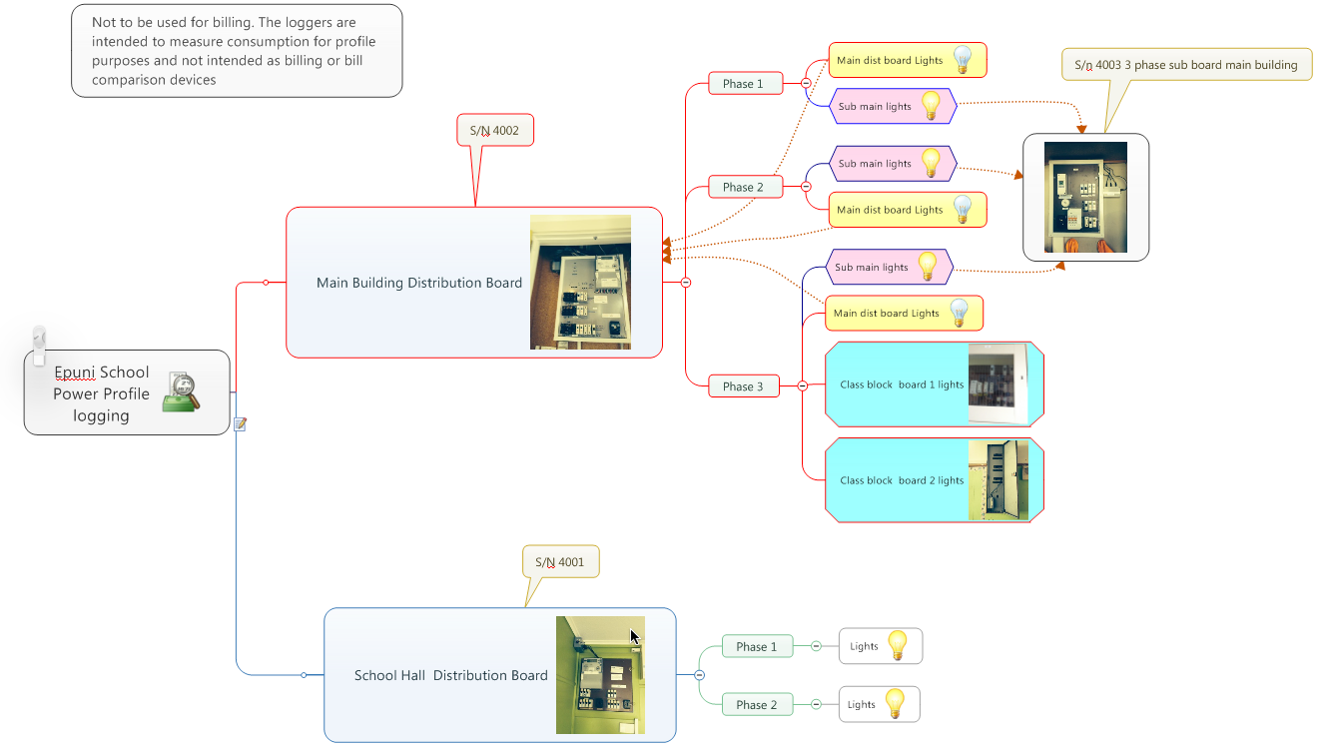
Logger Locations

Slide 5
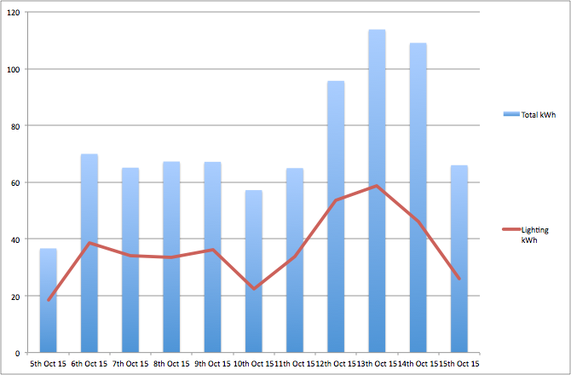
This data shows that approximately half of the school’s total power consumption, before conversion, was for lighting.
Date | Total kWh | Lighting kWh
5th Oct 15 | 36.69 | 18.39
6th Oct 15 | 69.99 | 38.6
7th Oct 15 | 65.12 | 34.24
8th Oct 15 | 67.29 | 33.44
9th Oct 15 | 67.19 | 36.14
10th Oct 15 | 57.22 | 22.3
11th Oct 15 | 64.97 | 33.85
12th Oct 15 | 95.73 | 53.72
13th Oct 15 | 113.82 | 58.852
14th Oct 15 | 109.09 | 46.22
15th Oct 15 | 66.01 | 26.009
Total | 813.12 | 401.761

Slide 6
School Hall – total kWh by day (example period)

Slide 7
Example of detail: kWh by hour – main building

Slide 8
Main School Building - lights/other share
Scale is kWh
_{LED lighting change}
_{over began}

Slide 9
Epuni School Main building - day/night lighting (12 months)
Change over to LED lighting

Slide 10
Main Building lights only Before and after comparison week on week
2nd to 6th Nov. 2015
Scale is kWh
Weekend
Days
23rd to 27th Nov. 2015

Slide 11
Main building - before and after lighting conversion and repair work -
 | 12th Oct - 11th Nov 2015 | 23rd Nov - 23rd Dec 2015 | difference (kWh) | percentage change
Total kWh | 2,385 | 1,685 | -700 | -29.35%
Lighting kWh | 990 | 183 | -807 | -81.52%
Note 1: this comparison gives an indication of the scope of reduction possible.
Note 2: The school Hall is not included as the variability of use
would skew results.

Slide 12
Main Building - Lighting split day/night
Scale is kWh
_{LED lighting changeover}
_{began}

Slide 13
Day/Night Definition
“Night” in the examples is hours between 5 pm and 8 am.
“Day” in the examples is hours between 8am and 5 pm.

Slide 14
Hall - Lighting kWh, showing day/night split
LED Update weekend
Scale is kWh

Slide 15
BACKGROUND
As part of the Dynamis Project, Epuni Primary School was chosen because it is a small, low decile school, with a very strong community and environmental bias.
The goal was to assess and document the effectiveness of using LED technology, to reduce the school’s power bills and their environmental footprint.
280 lamps in total, supplied by Ecopoint, were changed by an experienced electrician. This included not only the fluorescent tube lighting in the classrooms, but also the office, toilets, changing rooms, hall and flood lighting outside.

Slide 16
COSTS and SAVINGS
The total cost of this project was $14,100 plus GST.
As this was a trial, Ecopoint supplied the lamps and replacement fittings at cost. The electrician only charged for two of the three days work and the data loggers to measure the power savings were provided at cost.
It is estimated, that a small school would need to allow $18,000 to convert their school to LEDs.
They would also need to assign a project manager for the job. As part of the Dynamis Project I provided my time and expenses for free; (approximately $3,000)
Epuni Primary School's power bill for the previous year – 2015, was $4,714.00 – half of that was lighting ($2,357.00).
In 2016, Epuni’s power bill totalled $1,645.55.
So in their first year, they saved $1,645.55
LED lamps last for between 30,000 and 50,000 hours each. If they were running 9 hours day, 5 days week for 40 weeks a year, replacement would be needed between 16 and 27 years.

Slide 17
LED LIGHTING
In all cases, the LED lamps were brighter than the lamps they replaced - often many times brighter. In a couple of examples the Lux (lighting) levels went from 38 lux before conversion to 518 lux afterwards and 287 lux to 762 lux.
Power usage was logged for one month before and one month after the conversion. The results were amazing - an average of 81% reduction in lighting power use! Their overall power consumption dropped by more than 30% during the last twelve months.
This showed that true power savings were higher than manufacturers specifications, as the componentry on older fluorescent units heat up and draw a lot more power than is needed for efficient operation.
Infrared photographs taken at the school showed standard lamps running at over 100 degrees Celsius and the replaced LED lamp running at half that temperature. This reduced the maintenance costs throughout the school.
Changing exterior floodlights to LED units with movement sensors also made a considerable difference.

Slide 18
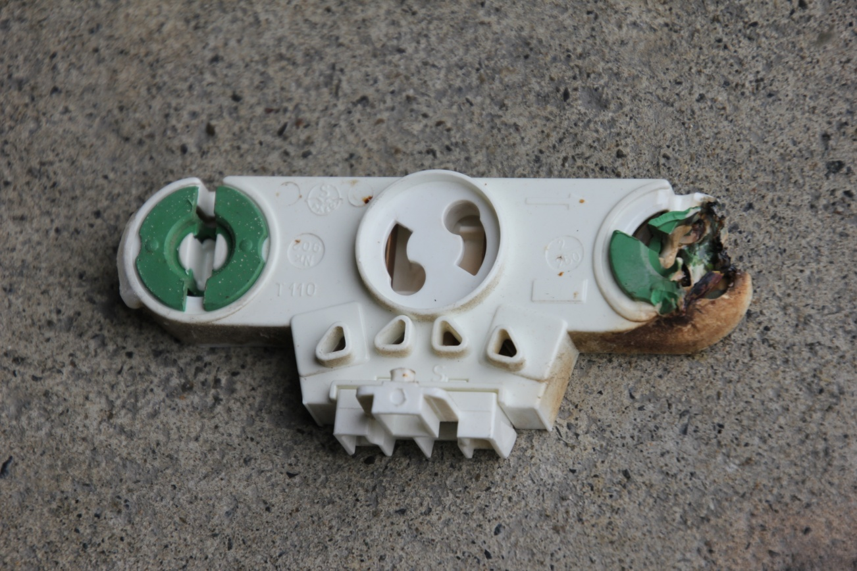
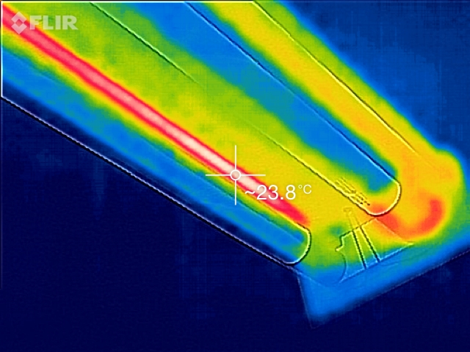
Burnt out fluorescent fitting
69.3°C
23.8°C
Highest temperature of an existing fluorescent fitting (left) and replacement LED fitting. (Infrared photos courtesy Tristram Buttner.)

Slide 19
Here is an example of the number of LED lamps fitted to a small school and the wattage reduction achieved with LEDs:
97 x 5ft fluoro tubes 65 watts reduced to 22 watts. 66% reduction
95 x 4ft fluoro tubes 58 watts reduced to 18 watts. 68% reduction
28 x circular ceiling lights 75 watts reduced to 18 watts. 76% reduction
31 x bayonet lamps fit 75 watts reduced to 12 watts. 84% reduction
17 x edison screw lamps 75 watts reduced to 12 watts. 84% reduction
7 x 400 watt exterior flood lamps reduced to 77 watts. 81% reduction
3 x edison screw 100 watts reduced to 9 watts. 91% reduction
2 x PAR 30 outside lights reduced to 30 watts. 60% reduction
3 x GU10 interior spotlights 50 watts reduced to 6 watts. 88% reduction
3 x edison R80 outside lights 80 watts reduced to 9 watts. 89% reduction

Slide 20
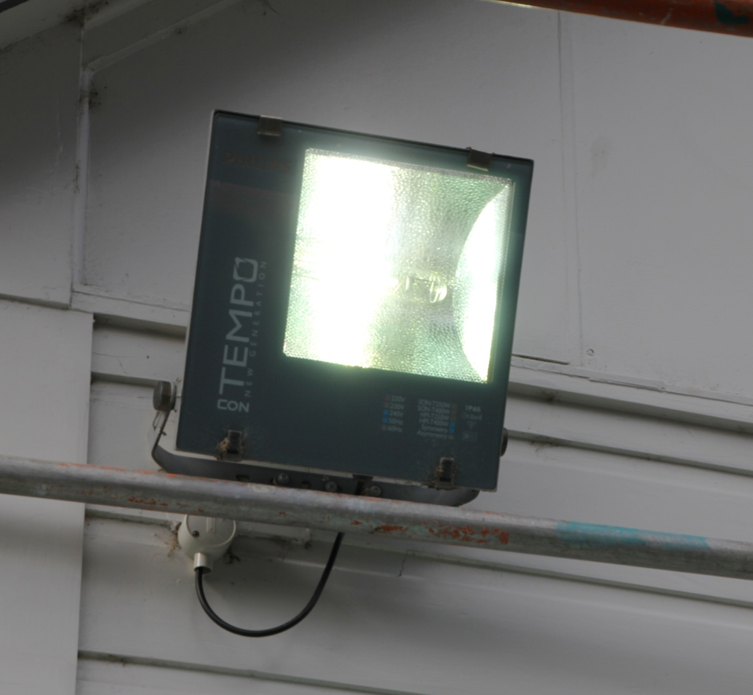
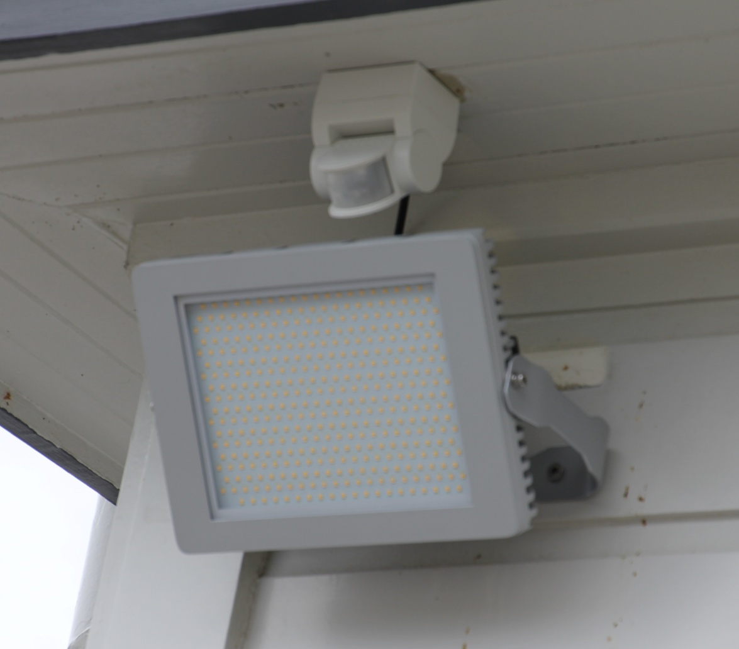
Floodlights consume a disproportionate amount of power and in some schools, run all night. On the left is a typical floodlight before replacement, - this unit burns through 400 watts of power every hour.
The replacement 120 watt LED unit on the right is brighter, gives a more even spread of light and uses a fraction of the power, as it is only activated when movement is detected.

Slide 21
Conclusion and Recommendations:
Epuni Primary School is typical of many schools in New Zealand. Most schools face the same problems with inefficient and power-hungry lighting.
Both fluorescent lighting in the classrooms and the outside floodlights need to be replaced, not only to save power but to reduce the likelihood of fittings over-heating.
The Ministry’s policy states, if schools can be more energy efficient, the savings they make from their operating fund can then be used in other areas.
It is my recommendation that this report be made freely available to all schools in New Zealand, so that they can make their own informed decisions on the costs and benefits available.
Mike Rathbone, Project Manager, Dynamis Project.

